Slide 1
Wear and contact fatigue properties of a novel lubricant additive
Professor Pedro Rivera^{1,2}
1 Lofrix Associates Limited
2 Lancaster University, University of Southampton

Slide 2
Content
Friction and tribofilm formation
Additives and dry lubrication
Anti-wear capabilities – roller -& spindle / shaft & break
Tribofilm adhesion – cutting tools
Evolution of coefficient of friction – rails steels
Nature of tribofilm – chemistry
Nature of tribofilm – physical properties
Statistical tests and future work
Notes:
Enter speaker notes here.

Slide 3
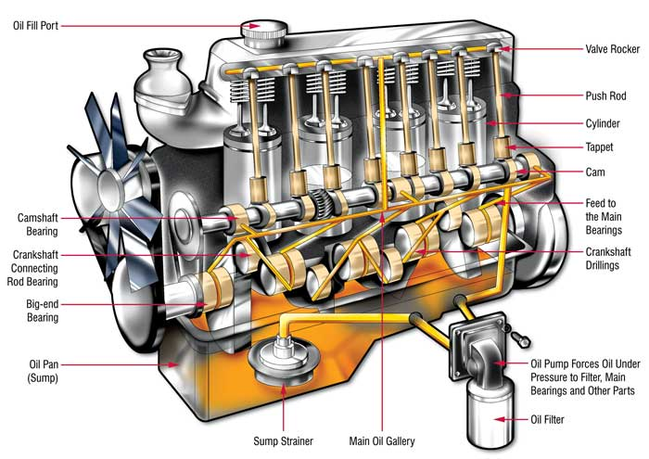
Wet lubrication
Notes:
Enter speaker notes here.

Slide 4
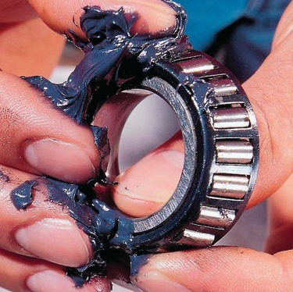
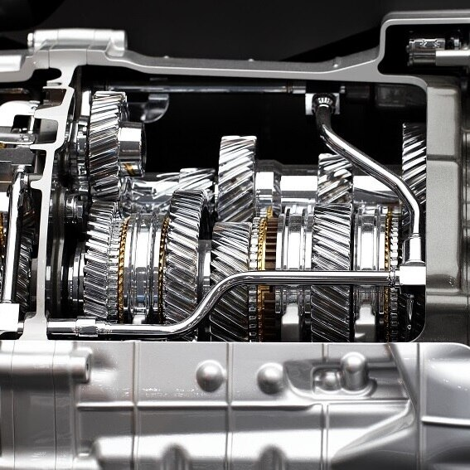
Contact and slide
Notes:
Enter speaker notes here.

Slide 5
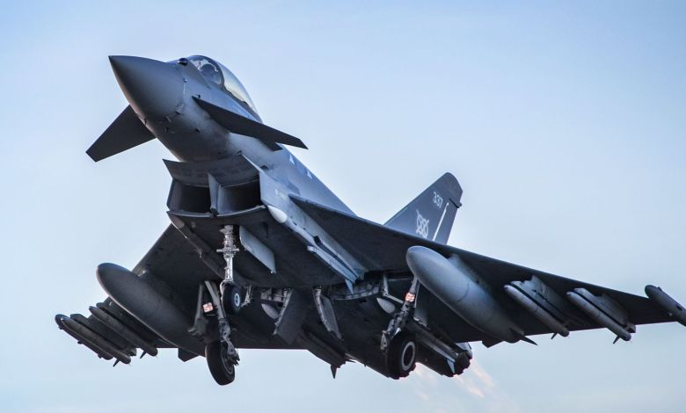
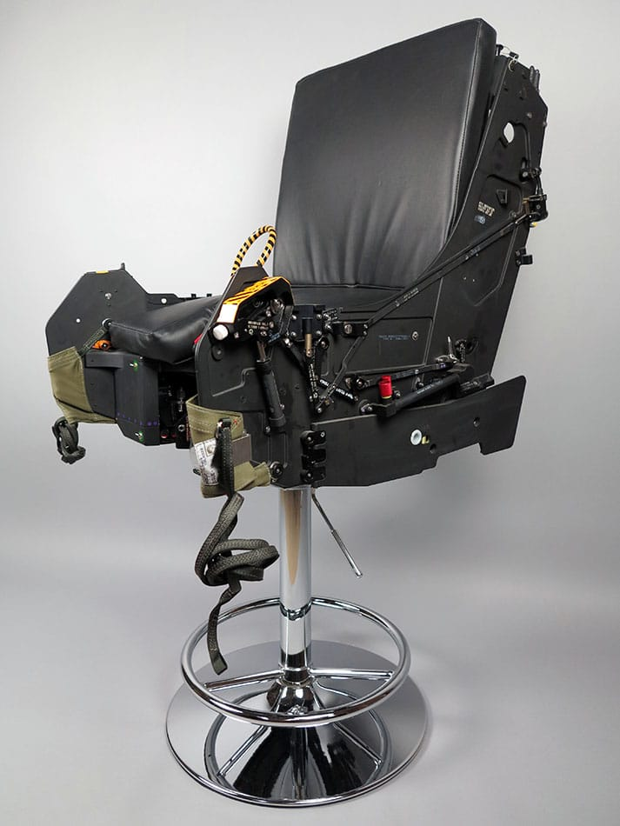
Lofrix Dry – Typhoon fighter
British Aerospace Military Aircraft & Structures
Tribological and tribo-chemical test results
Wear Resistance and Friction Coefficient study
-60 to 60 ºC dry lubrication
Notes:
Enter speaker notes here.

Slide 6
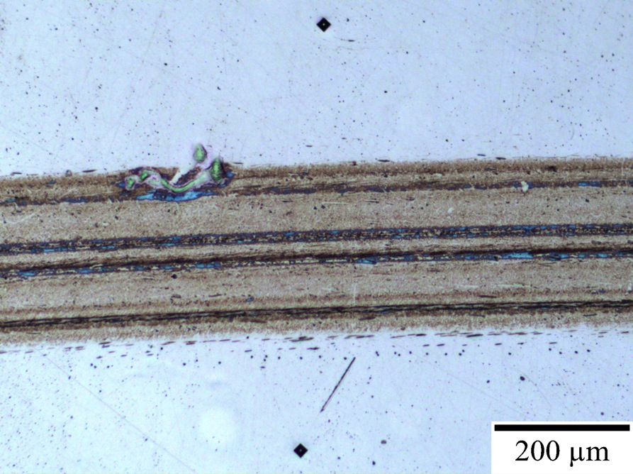
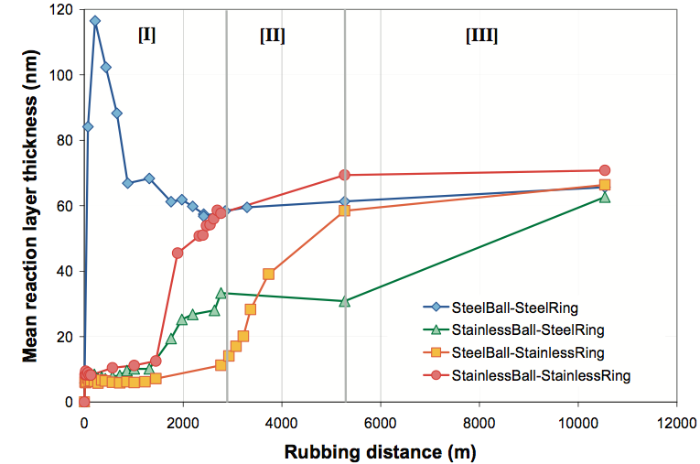
1. Friction and tribofilm formation
1. Mechanical contact is necessary to form the tribofilm.
ZDDP tribofilm on 100Cr6 steel MTM disc
“wear” track
52100 ball and disc
440C ball, 52100 disc
52100 ball, 440C disc
440C ball and disc
2. Behaviour of the anti-wear additives depends on the steel grade used.
Notes:
Enter speaker notes here.

Slide 7
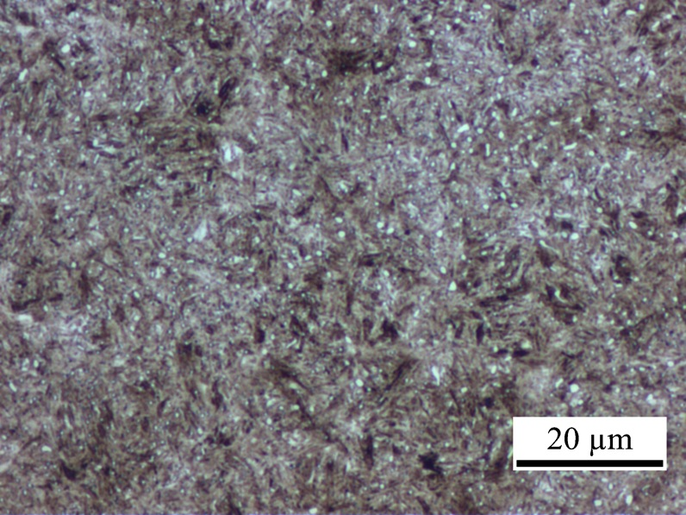
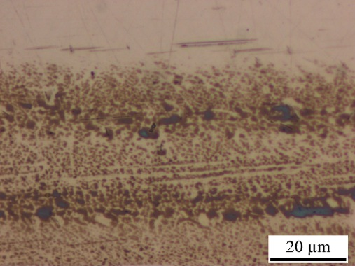
1. Friction and tribofilm formation
3. Anti-wear additives form patches of the tribofilm on the surface. Scale is similar to that of the microstructure.
52100 steel microstructure, nital etched.
ZDDP tribofilm on 52100 steel, MTM test.
Notes:
Enter speaker notes here.

Slide 8
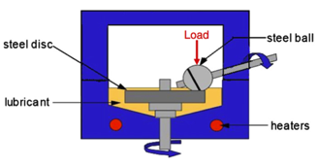
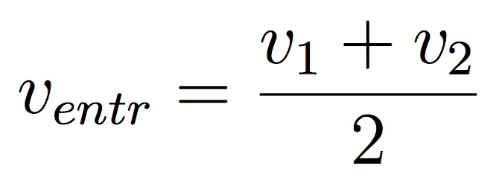
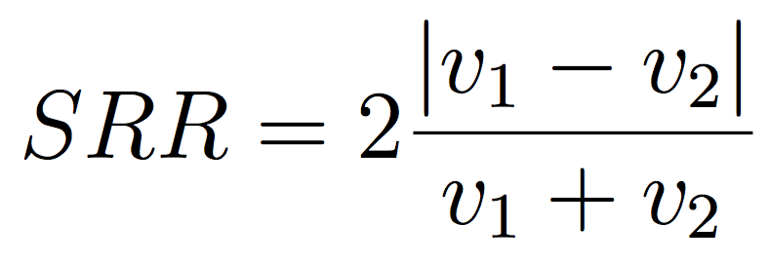
1. Friction and tribofilm formation
Controlled parameters:
Load
Disc and ball speed
Temperature
Measured:
Tribofilm thickness vs time (interrupt test)
Coefficient of friction vs time
“Striebeck” curves: COF vs rolling speed (interrupt test)
In “timed step” (normal operating mode) disc moves faster than the ball. In “Striebeck step” two measurements are done; one with ball moving faster and one with disc moving faster.
Notes:
Enter speaker notes here.

Slide 9
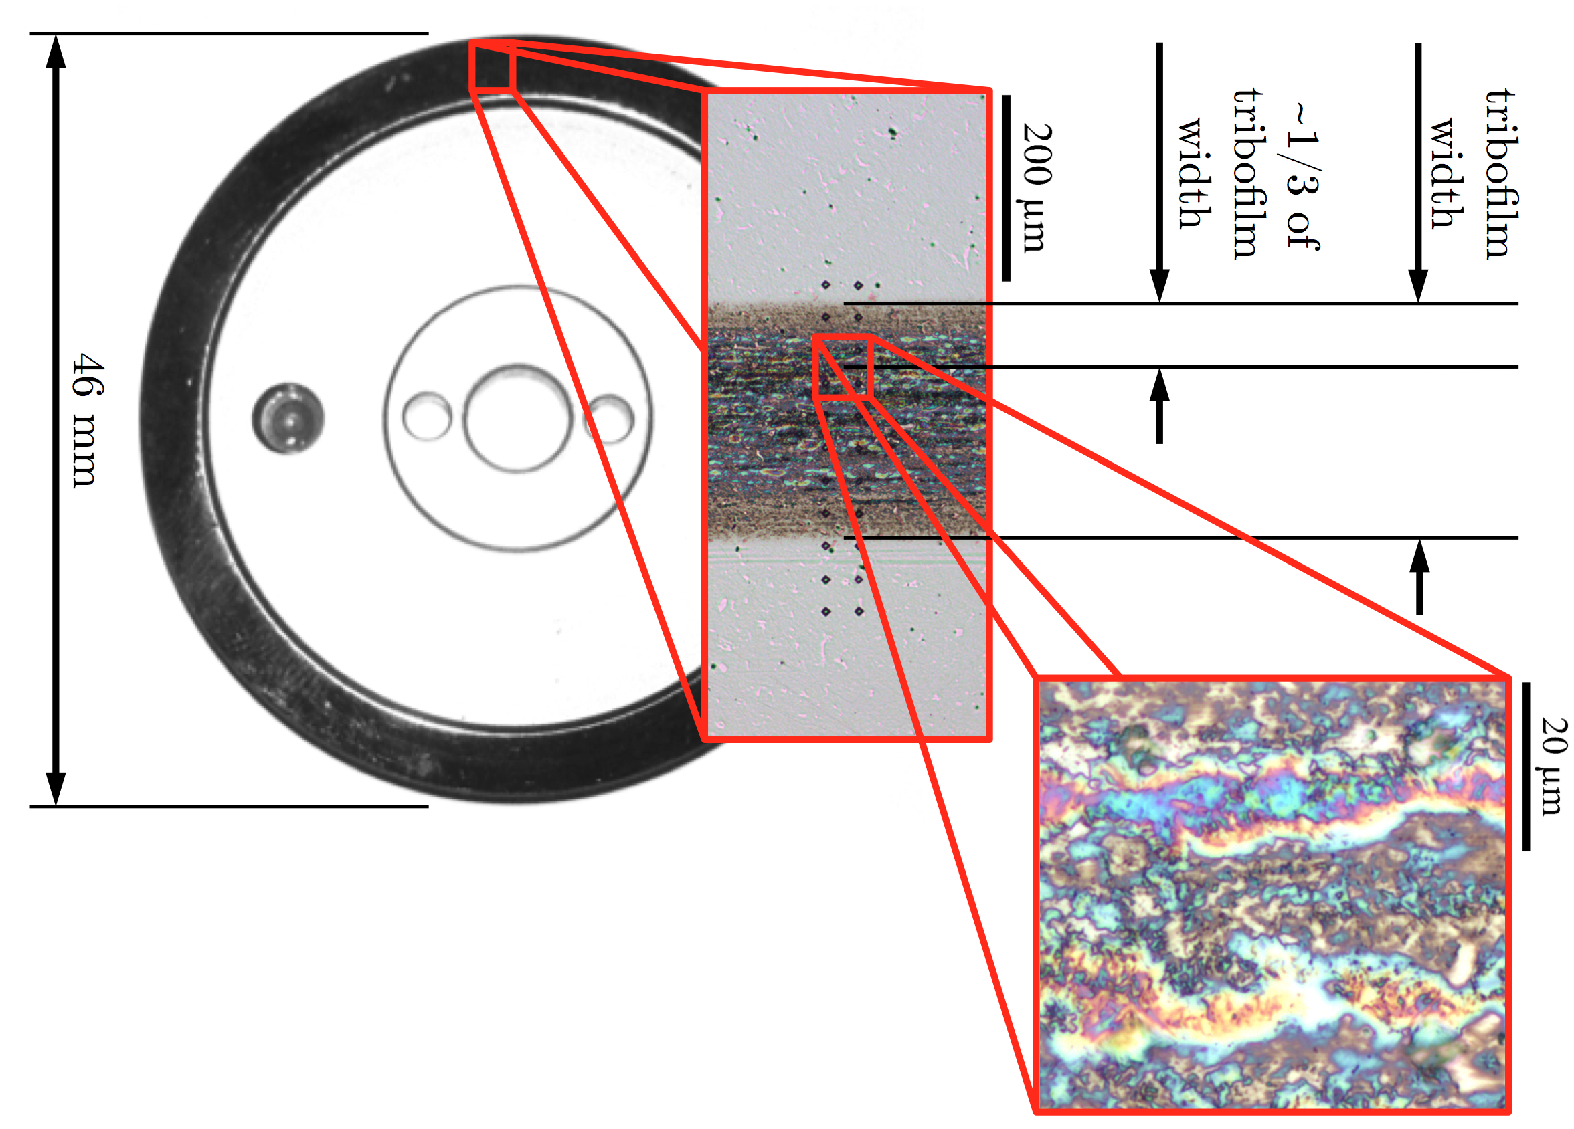
2. Additives and dry lubrication
9
Notes:
Enter speaker notes here.

Slide 10
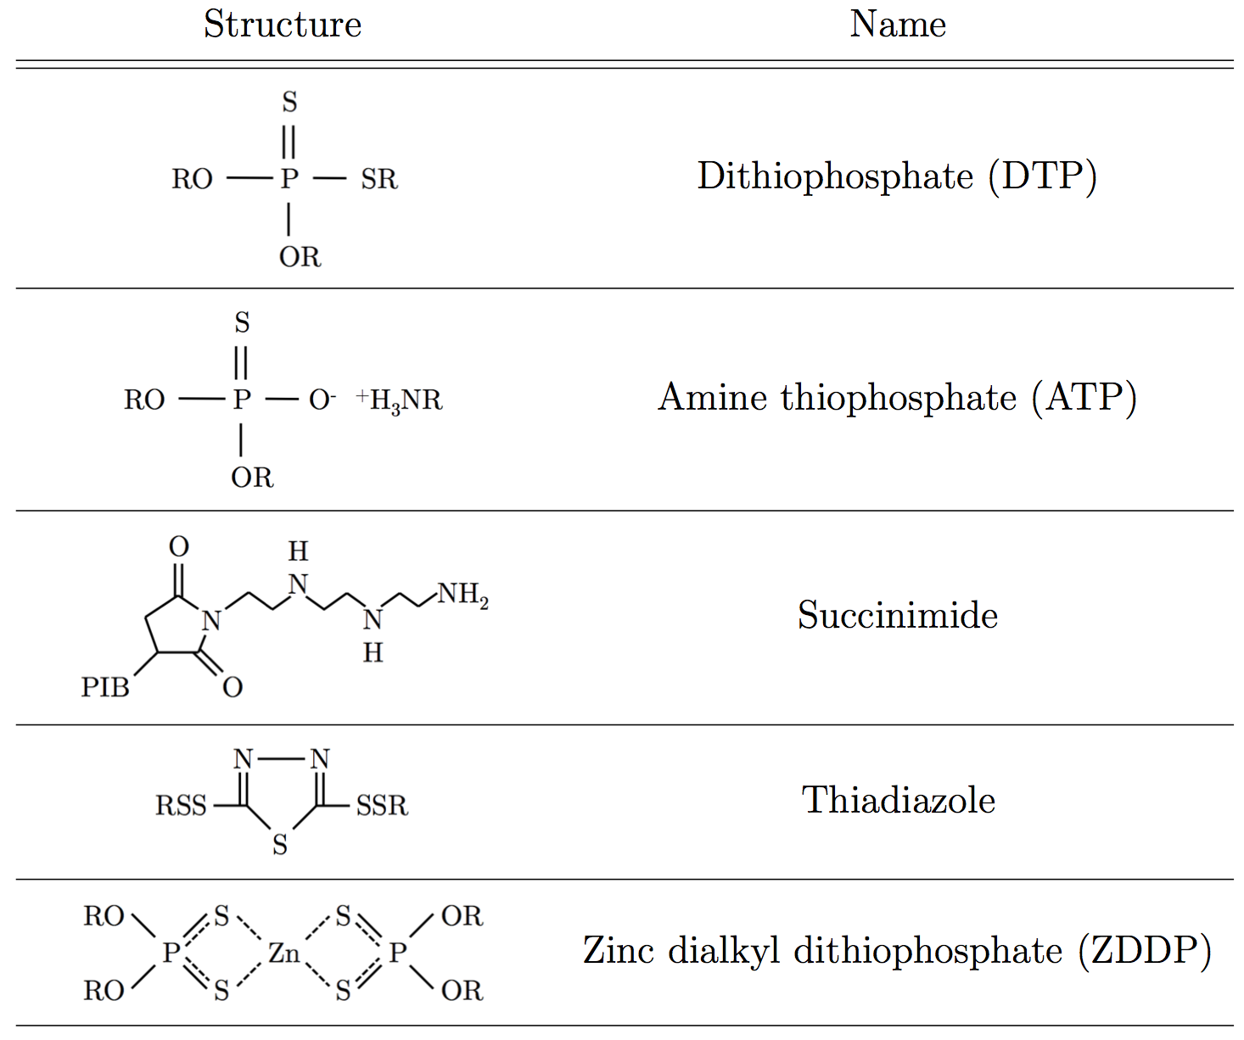
2. Additives and dry lubrication
Notes:
Enter speaker notes here.

Slide 11
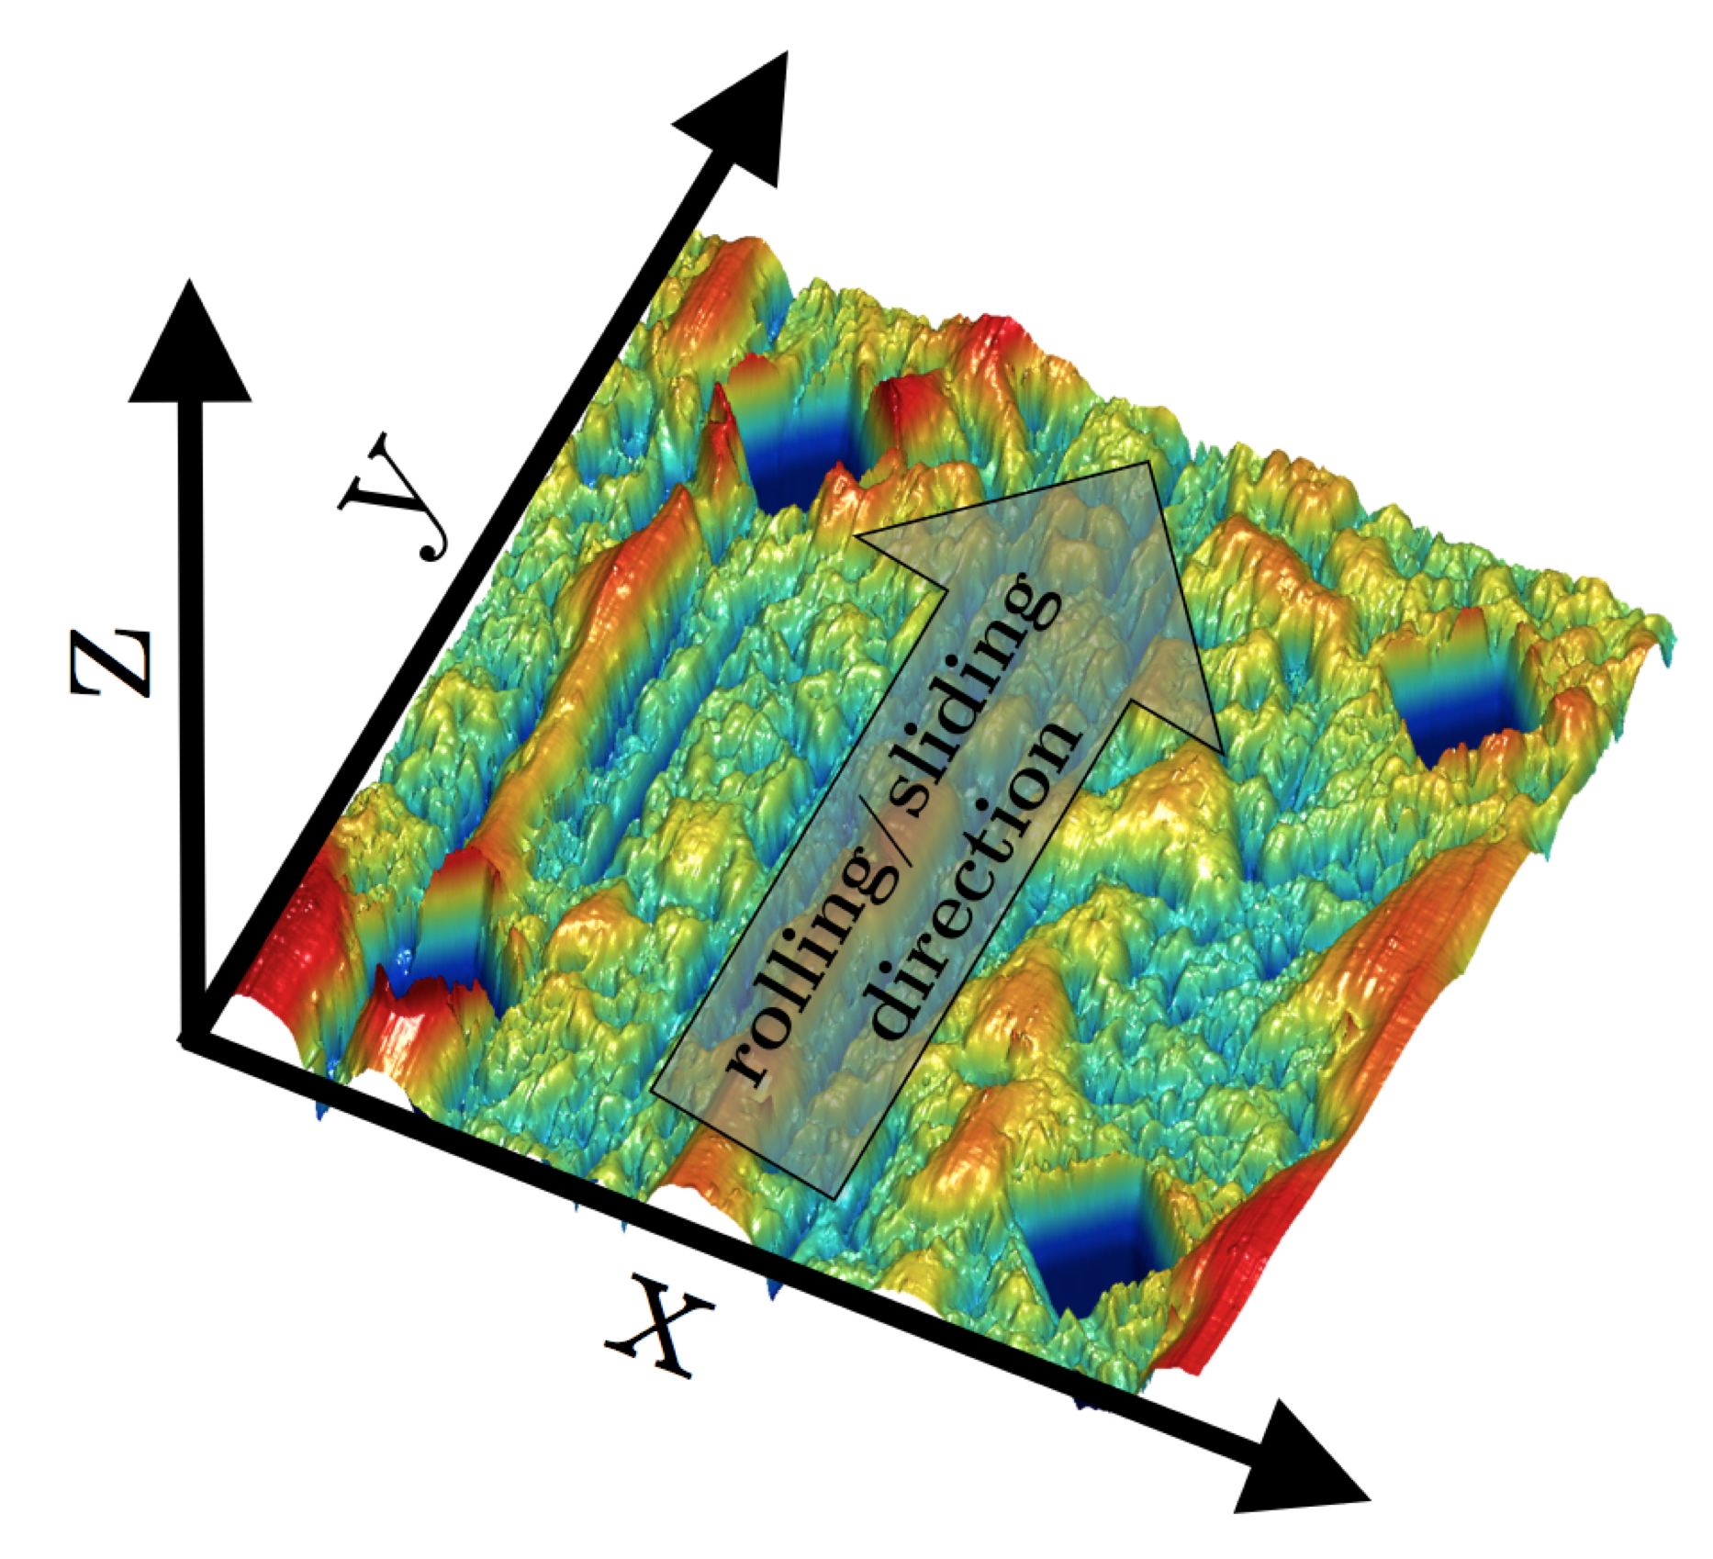
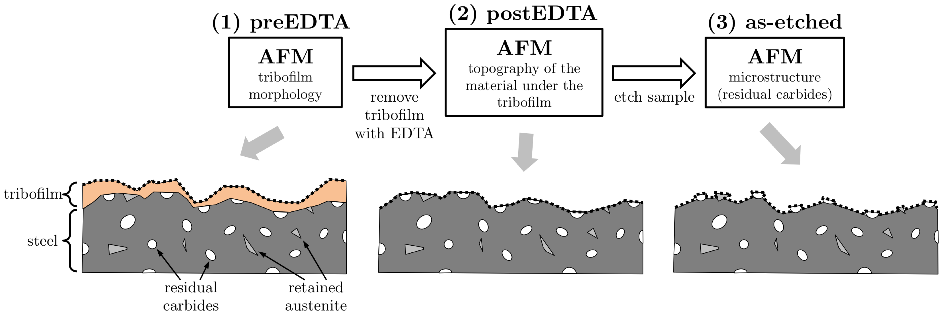
2. Additives and dry lubrication
EDTA – Ethylenediaminetetraacetic acid
Notes:
Enter speaker notes here.

Slide 12
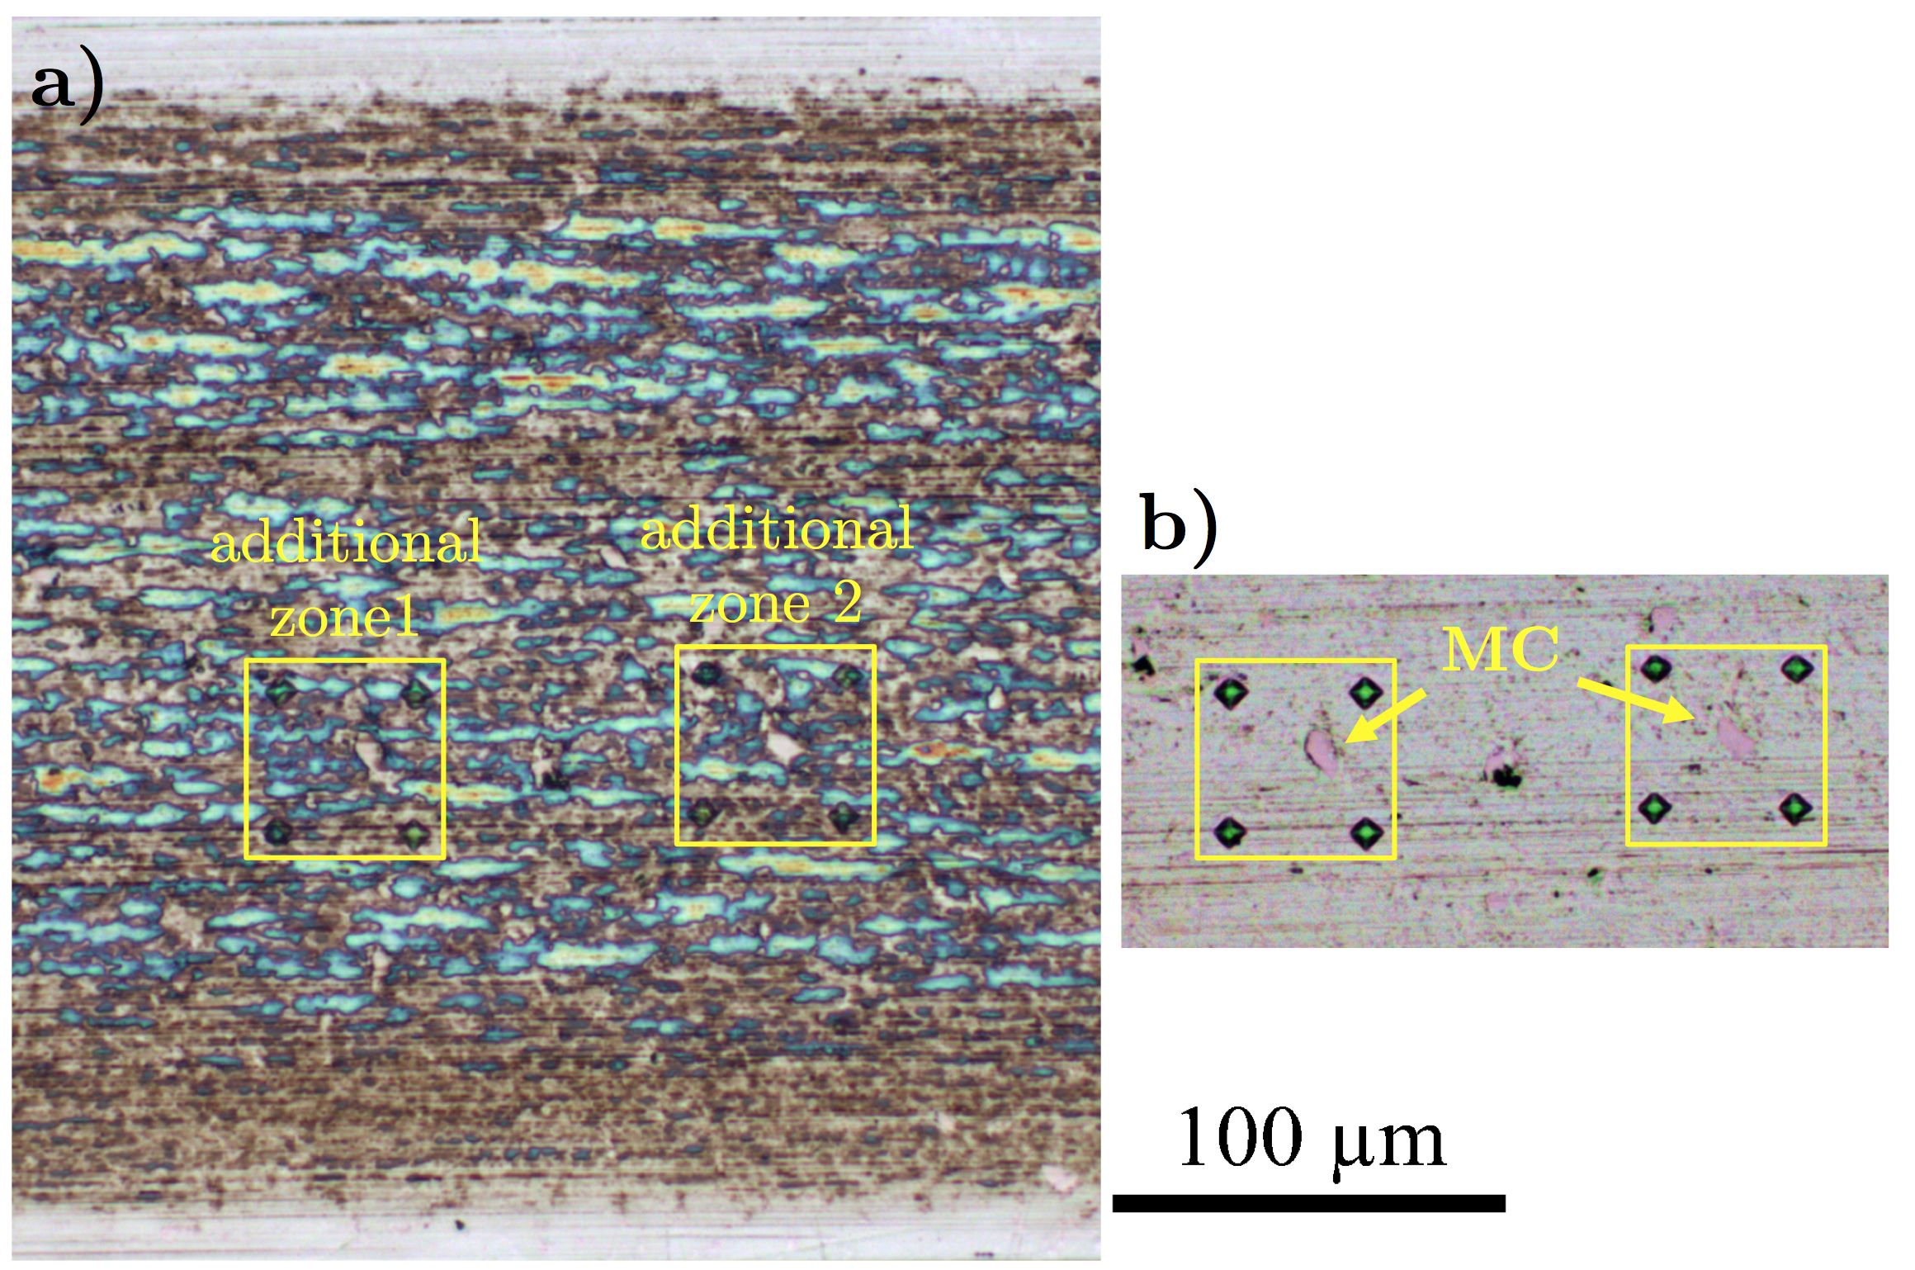
2. Additives and dry lubrication
Tribofilm-microstructure correlation (M2/ZDDP-large residual carbides)
12
12
Notes:
Enter speaker notes here.

Slide 13
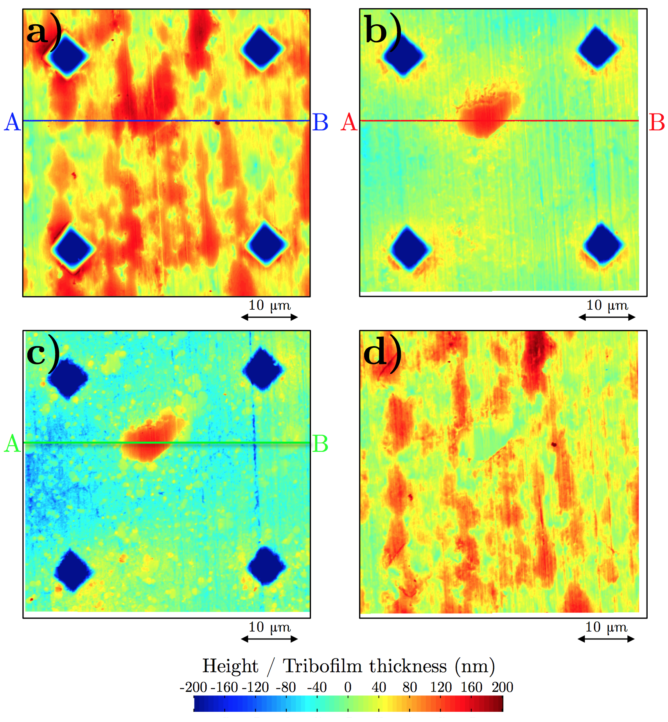
2. Additives and dry lubrication
Tribofilm-microstructure correlation (M2/ZDDP-large residual carbides)
Jelitay Rydel et al. Tribology International 98 (2016) 74–81; 113 (2017) 13–25
Notes:
Enter speaker notes here.

Slide 14
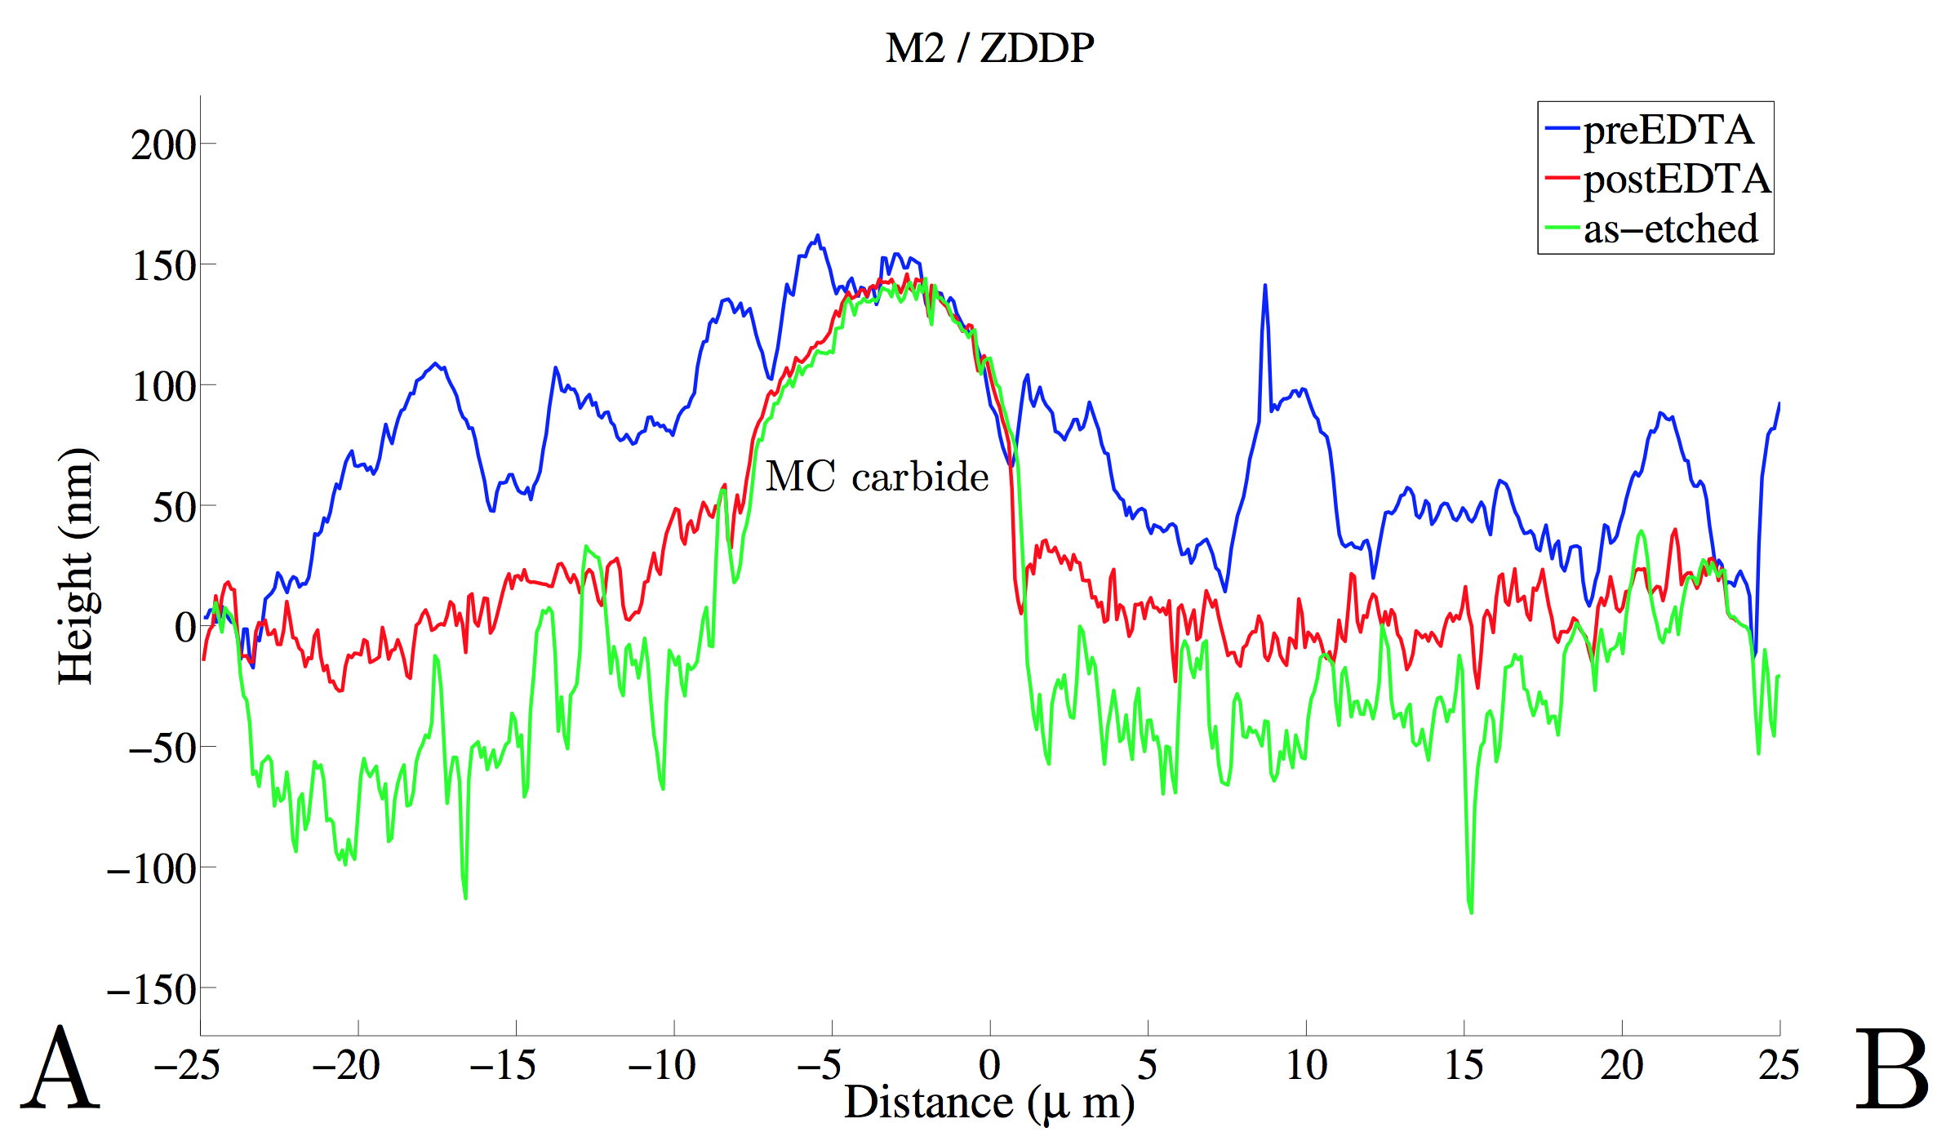
2. Additives and dry lubrication
Tribofilm-microstructure correlation (M2/ZDDP-large residual carbides)
Jelitay Rydel et al. Tribology International 98 (2016) 74–81; 113 (2017) 13–25
14
Notes:
Enter speaker notes here.

Slide 15
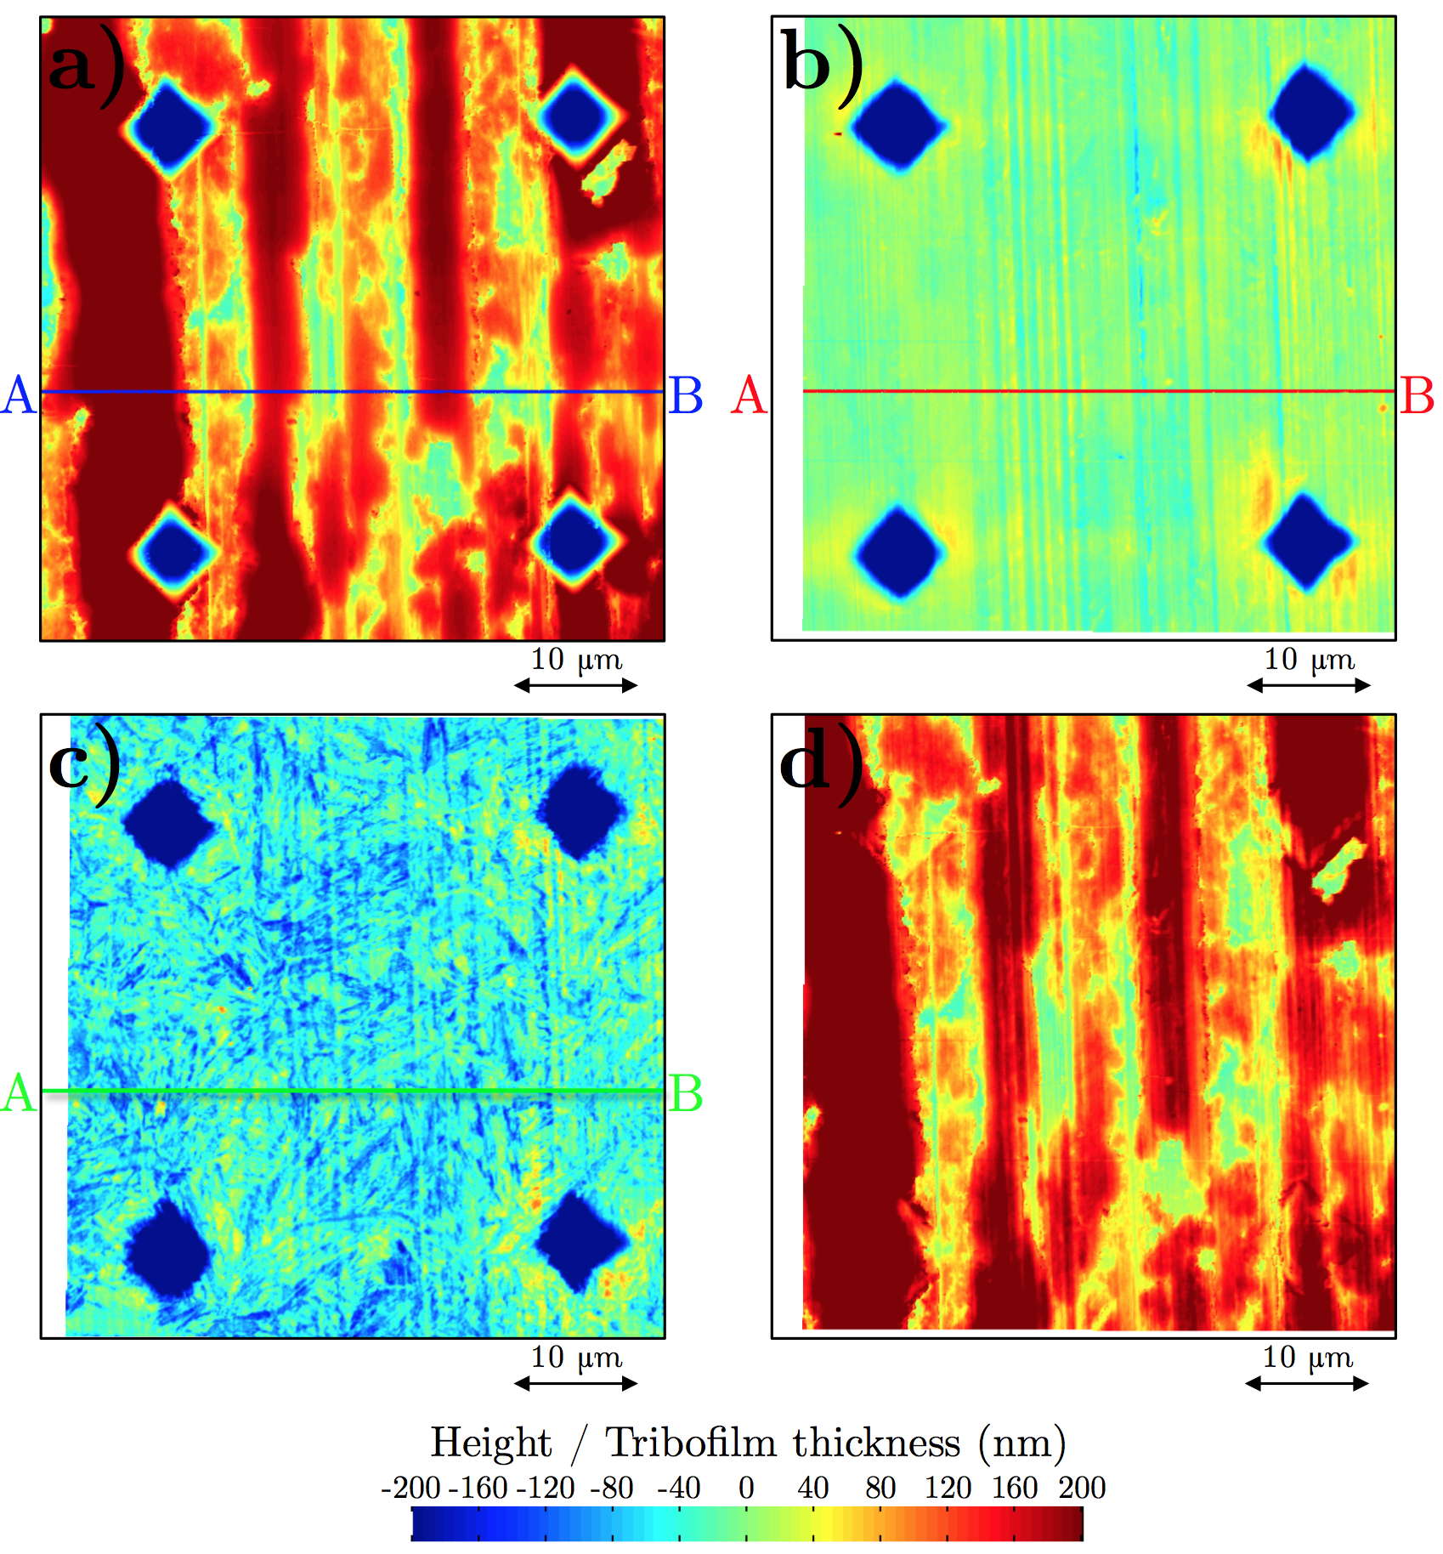
2. Additives and dry lubrication
Tribofilm-microstructure correlation (16MnCr5/ZDDP)
Jelitay Rydel et al. Tribology International 98 (2016) 74–81; 113 (2017) 13–25

Slide 16
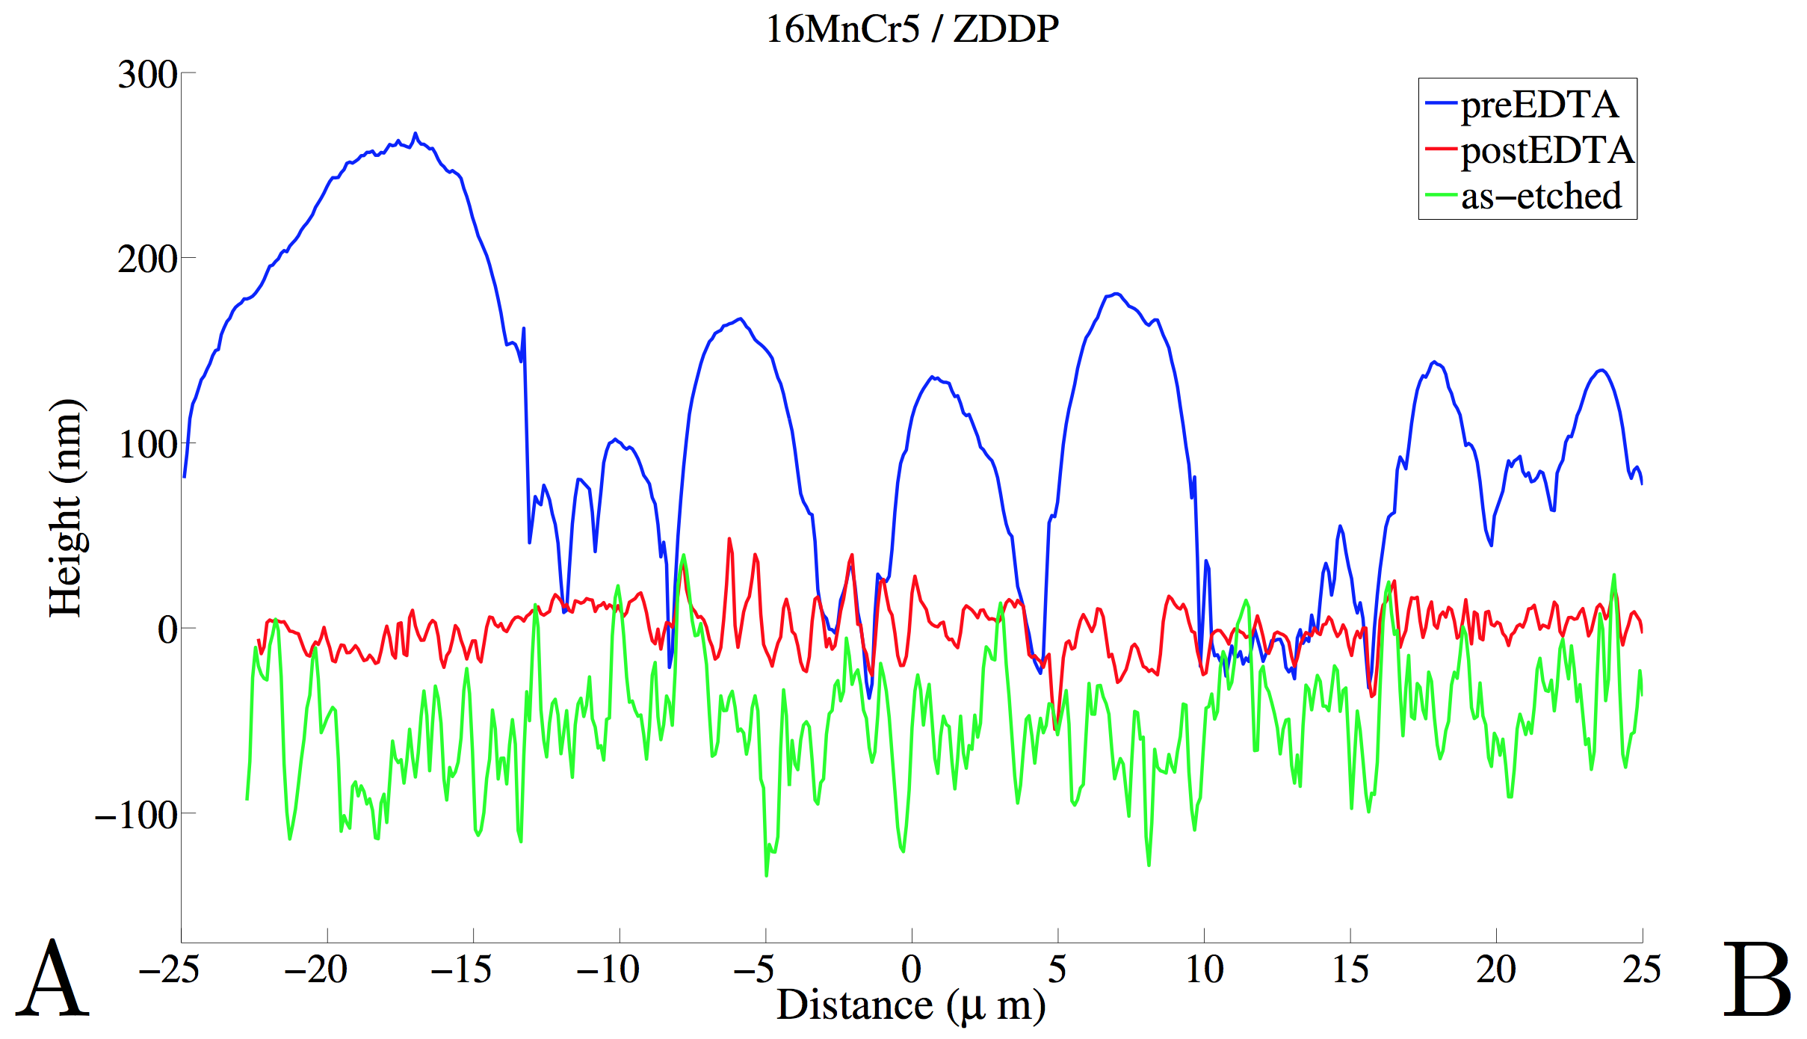
2. Additives and dry lubrication
Tribofilm-microstructure correlation (16MnCr5/ZDDP)
Jelitay Rydel et al. Tribology International 98 (2016) 74–81; 113 (2017) 13–25

Slide 17
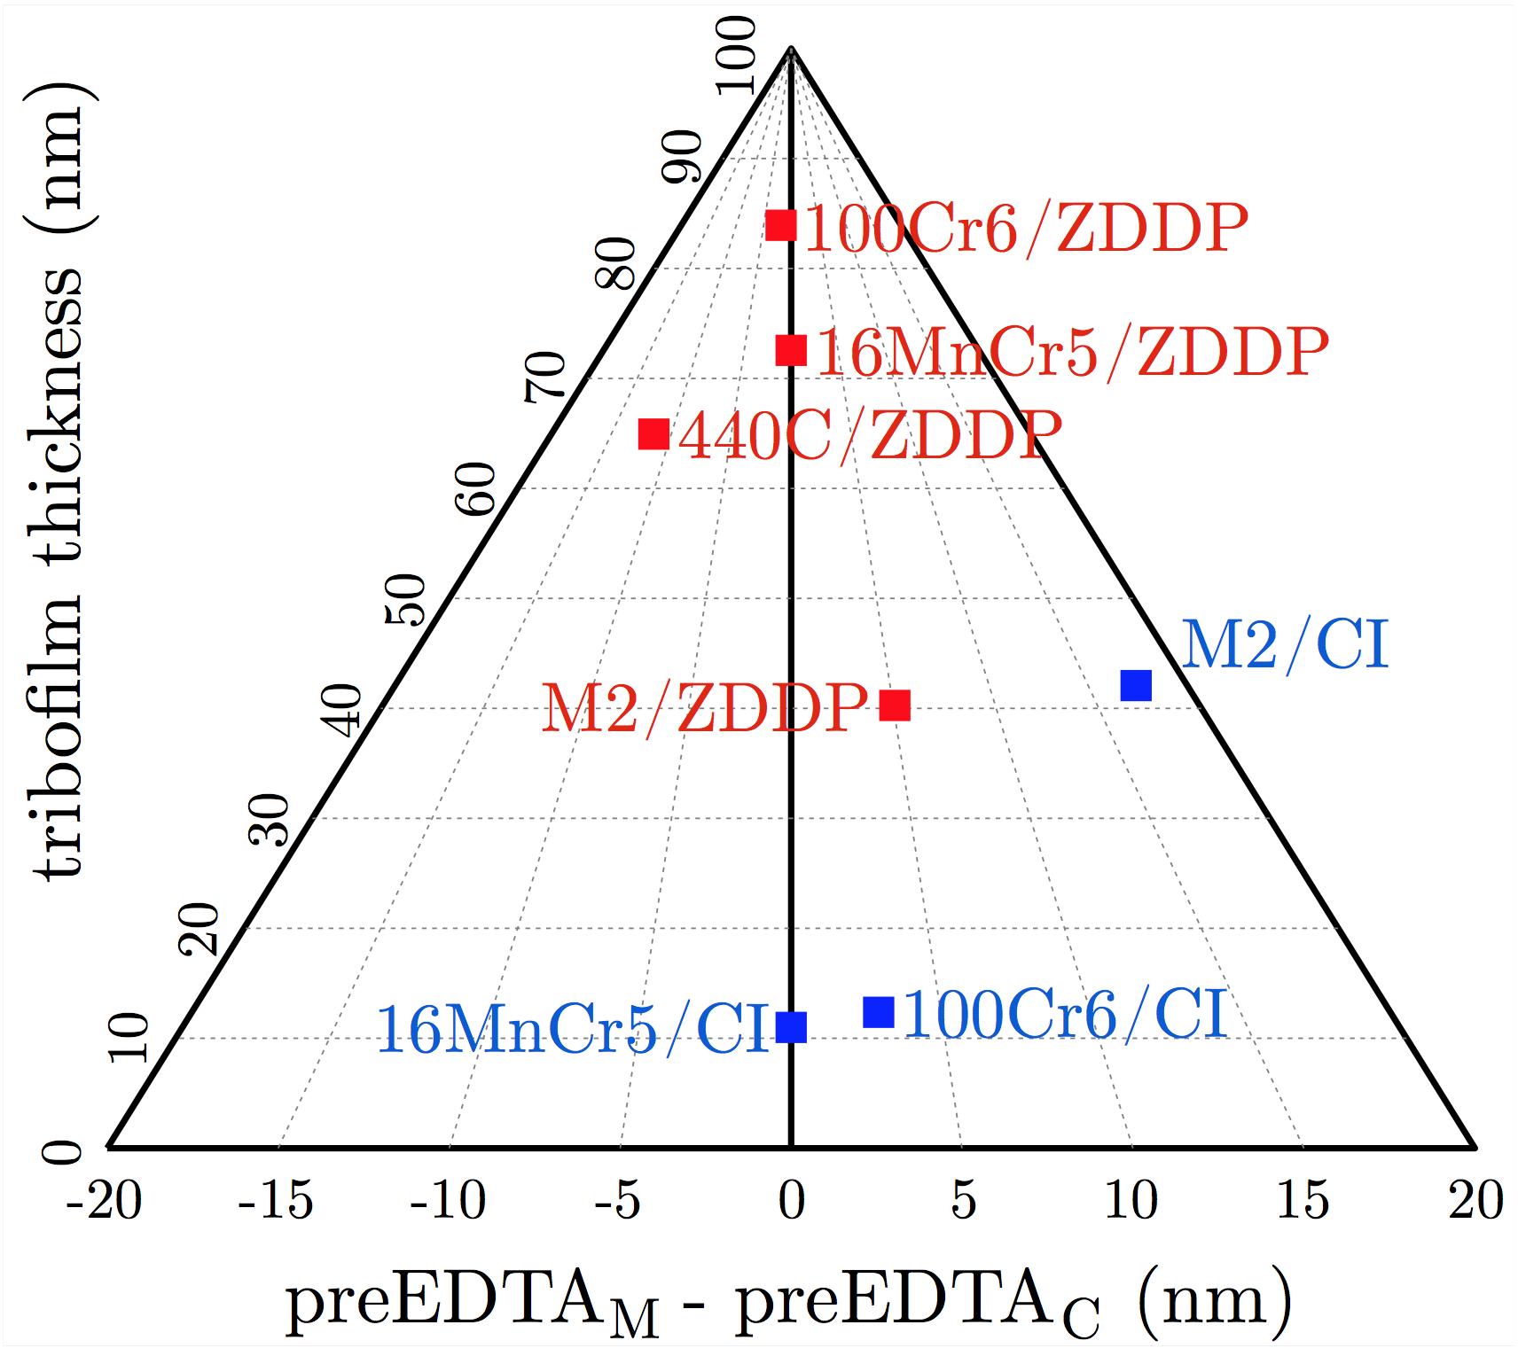
2. Additives and dry lubrication
Tribofilm-microstructure correlation (summary)
CI = Corrosion inhibitor
Jelitay Rydel et al. Tribology International 98 (2016) 74–81; 113 (2017) 13–25

Slide 18
What is the tribofilm structure in dry lubricants? Can pressure be avoided? Is a wet lubricant required?
Notes:
Enter speaker notes here.

Slide 19
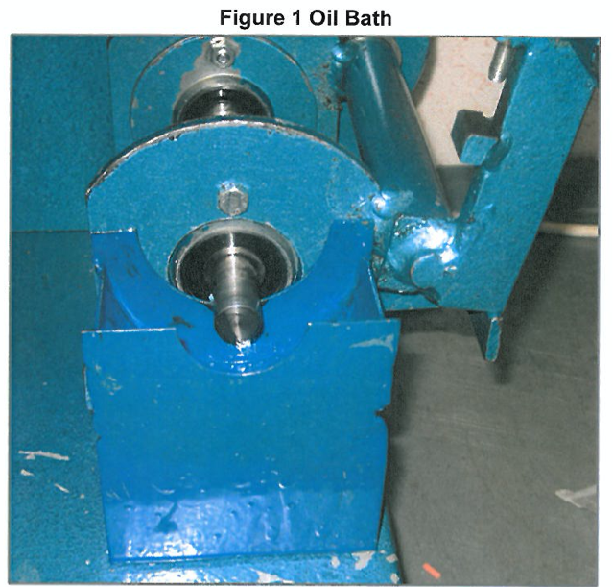
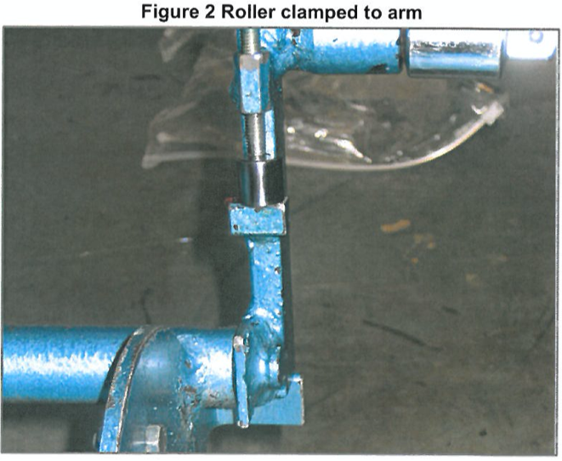
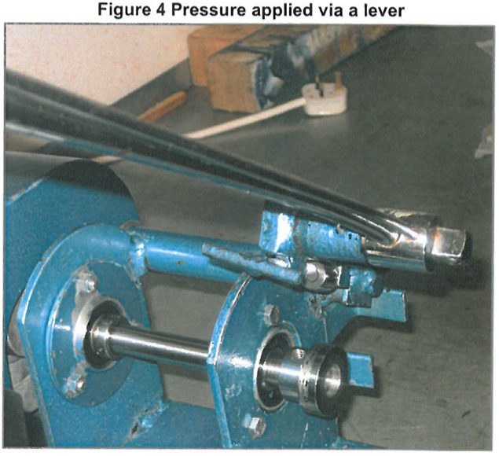
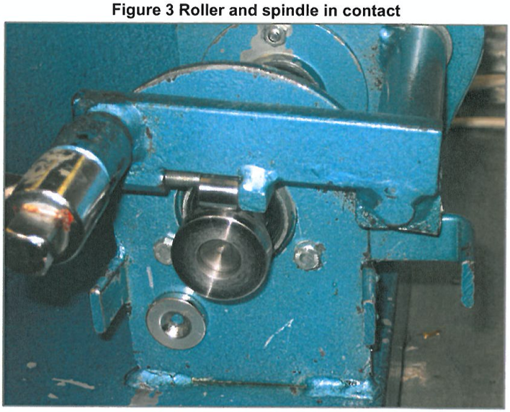
3. Anti-wear capabilities – roller -& spindle / shaft & break
Courtesy: Professor Andrew Ball, University of Huddresfield
Notes:
Enter speaker notes here.

Slide 20
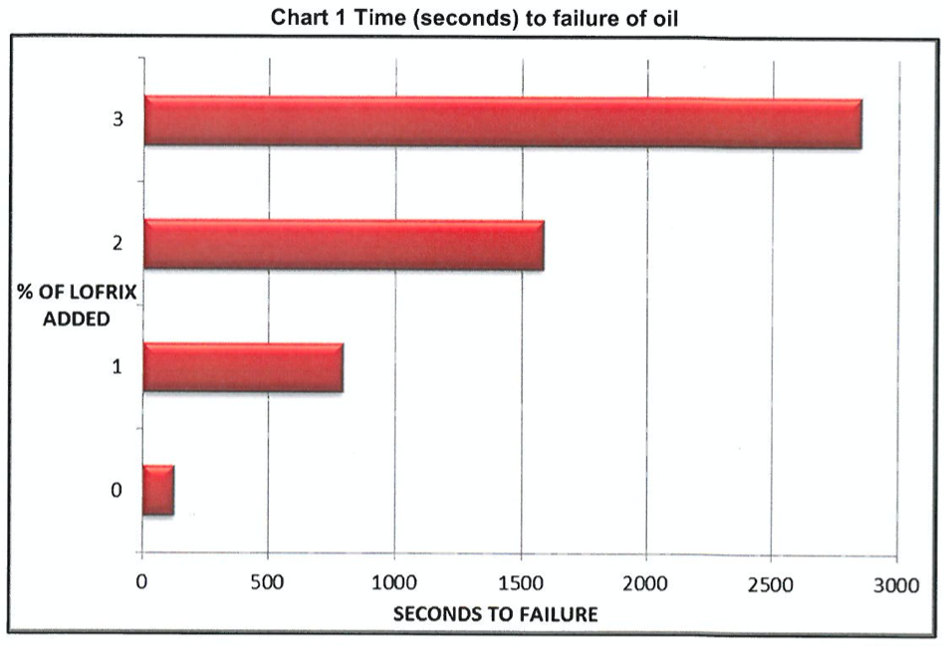
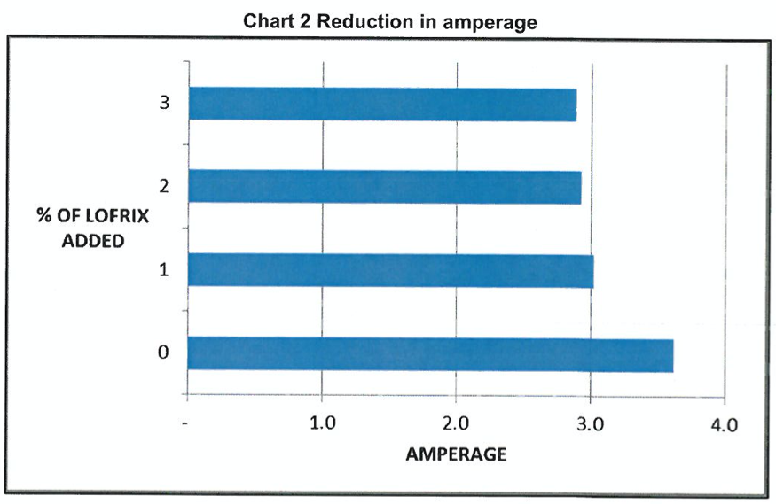
3. Anti-wear capabilities – roller -& spindle / shaft & break
Courtesy: Professor Andrew Ball, University of Huddersfield
Notes:
Enter speaker notes here.

Slide 21
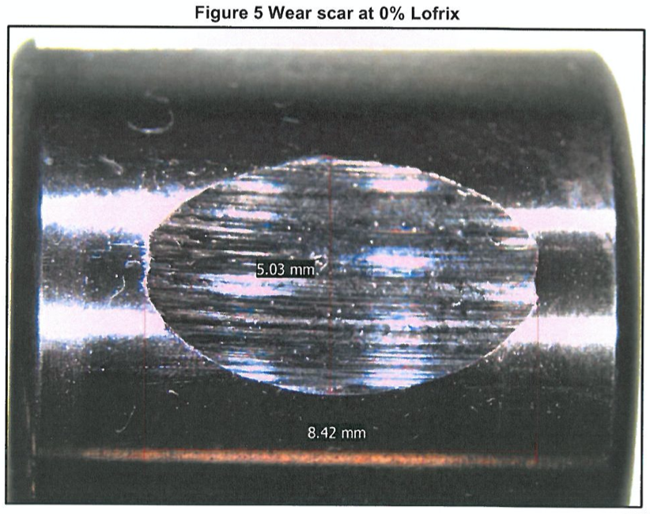
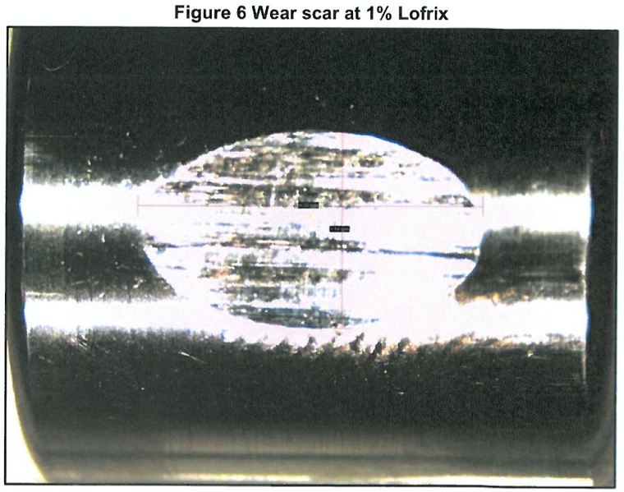
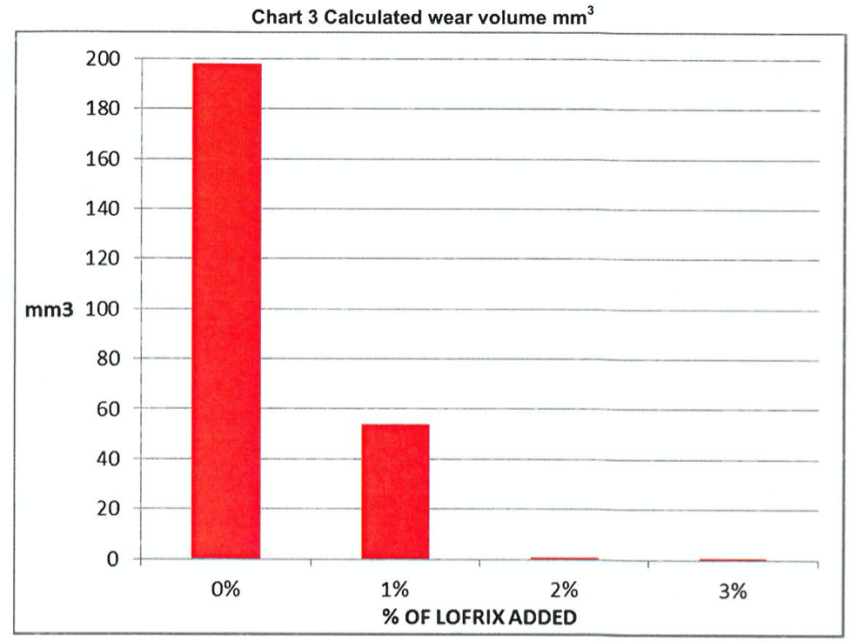
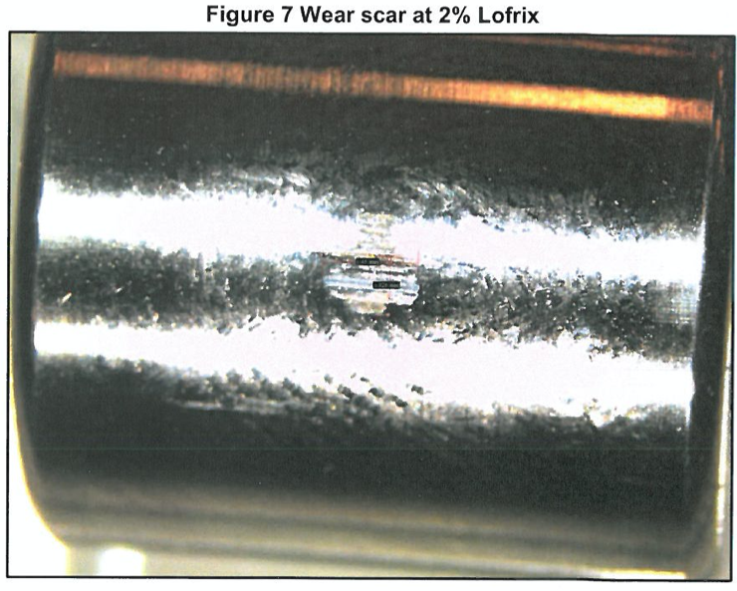
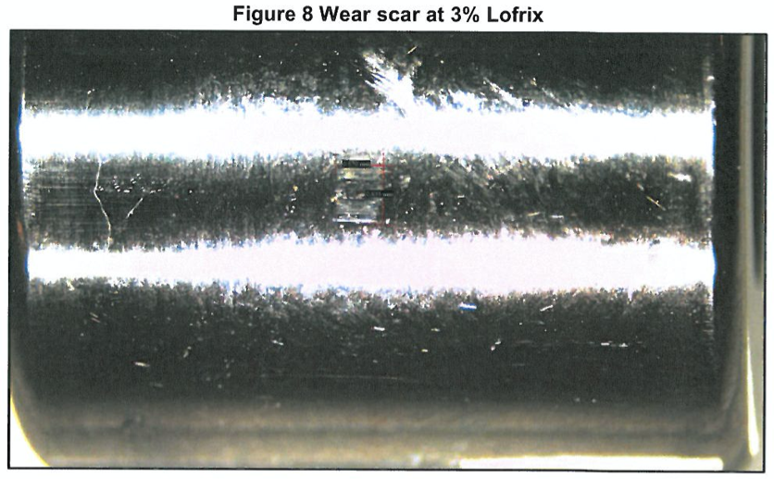
3. Anti-wear capabilities – roller -& spindle / shaft & break
Courtesy: Professor Andrew Ball, University of Huddrersfield
Notes:
Enter speaker notes here.

Slide 22
4. Tribofilm adhesion – cutting tools
Steve Townley, Advanced Manufacturing
and Research Centre, University of Sheffield
Notes:
Enter speaker notes here.

Slide 23
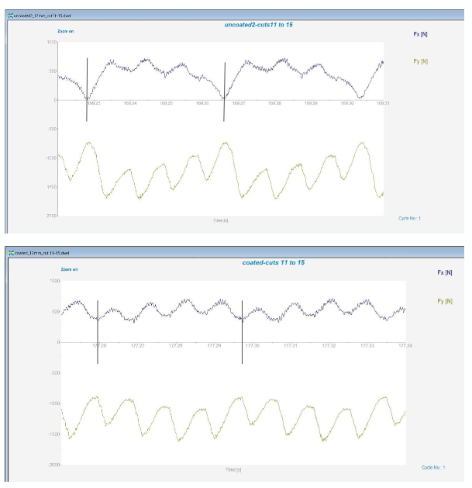
4. Tribofilm adhesion – cutting tools
Steve Townley, Advanced Manufacturing and Research Centre, University of Sheffield
Notes:
Enter speaker notes here.

Slide 24
4. Tribofilm adhesion – cutting tools
Steve Townley, Advanced Manufacturing and Research Centre, University of Sheffield
Notes:
Enter speaker notes here.

Slide 25
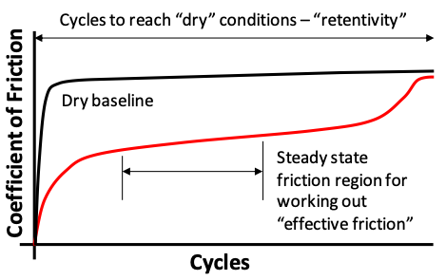
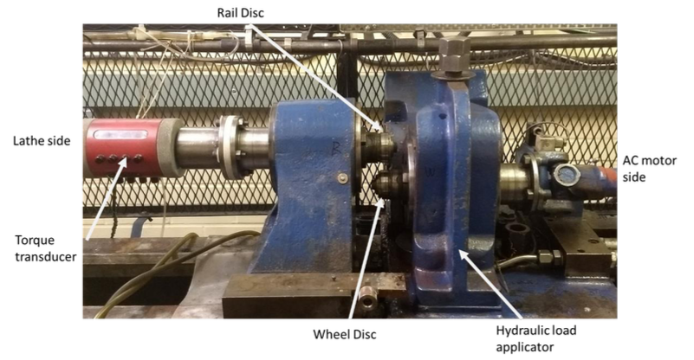
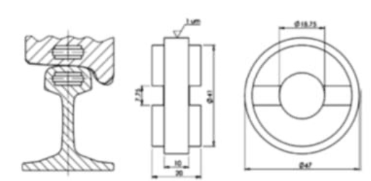
5. Evolution of coefficient of friction – rails steels
No lubrication
Courtesy Professor Roger Lewis, University of Sheffield
Notes:
Enter speaker notes here.

Slide 26
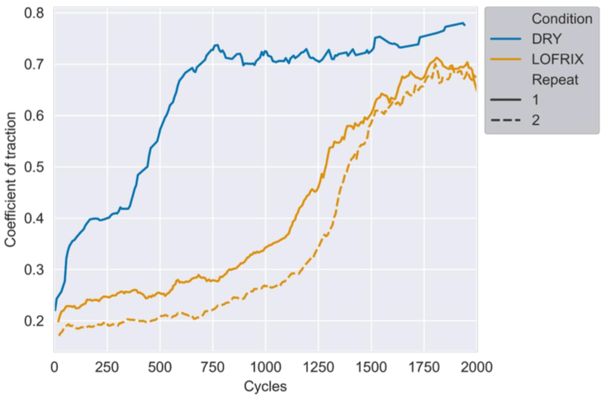
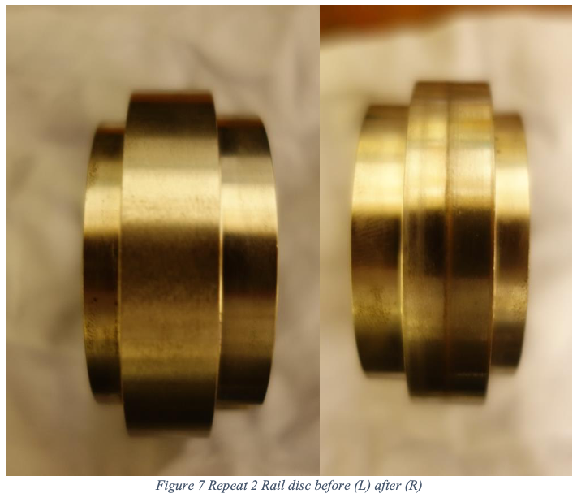
5. Evolution of coefficient of friction – rails steels
Courtesy Professor Roger Lewis, University of Sheffield
Notes:
Enter speaker notes here.

Slide 27
5. Evolution of coefficient of friction – rails steels
Courtesy Professor Roger Lewis, University of Sheffield
Notes:
Enter speaker notes here.

Slide 28
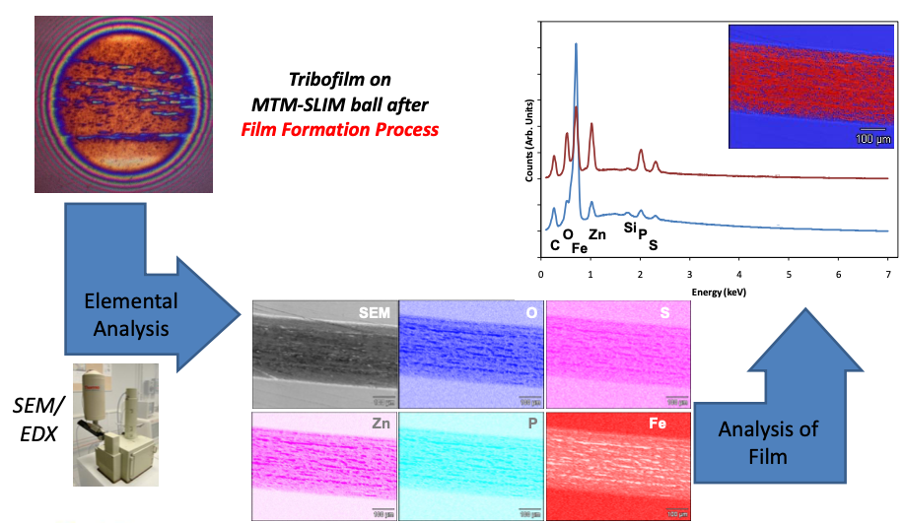
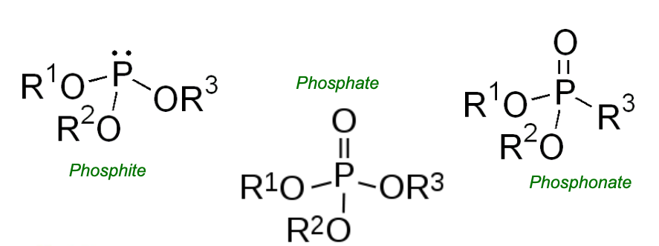
6. Nature of tribolayer – chemistry
Three classes of ashless antiwear additives studied
R groups were also varied
Courtesy of Jeffrey M. Guevremont, Afton Chemicals
Notes:
Enter speaker notes here.

Slide 29
6. Nature of tribolayer – Lofrix chemistry
Alkanes
*
* Institute for Health and Consumer Protection European Chemicals Bureau, I-21020 Ispra (VA) Italy
Notes:
Enter speaker notes here.

Slide 30
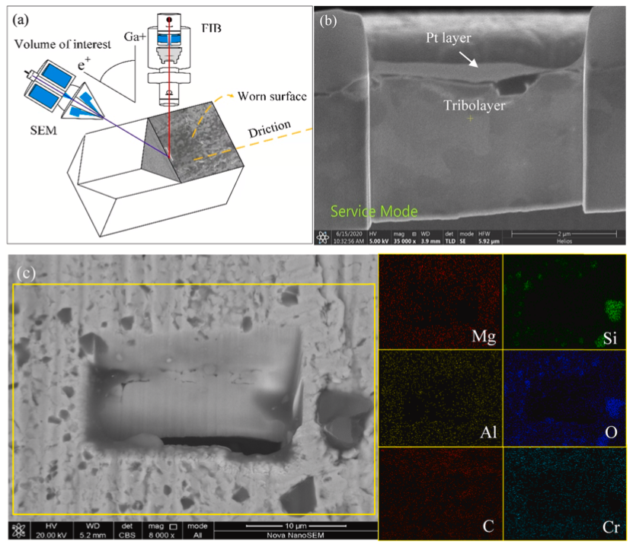
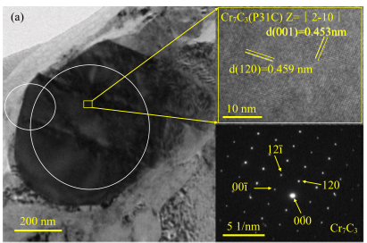
7. Nature of tribolayer – physical properties
Courtesy: Zhang et al. Tribology International 173 (2022) 107637
Notes:
Enter speaker notes here.

Slide 31
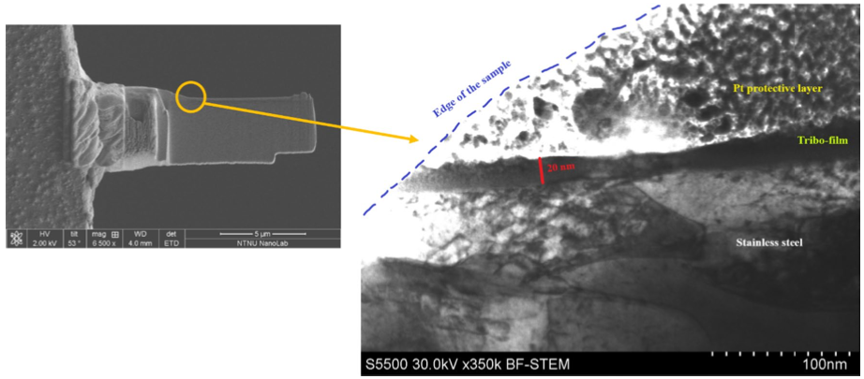
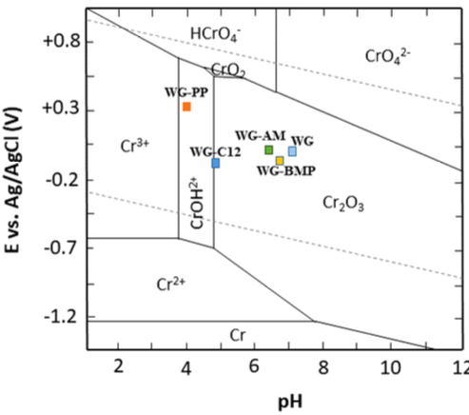
7. Nature of tribolayer – physical properties
Courtesy: Khanmohammadi et al. Tribology Letters (2020) 68:130
Notes:
Enter speaker notes here.

Slide 32
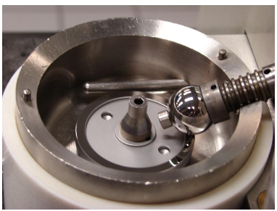
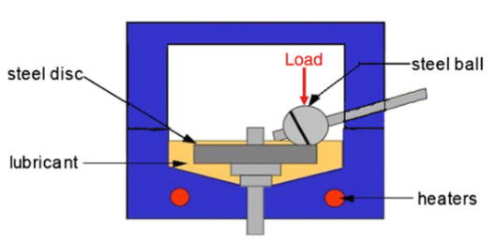
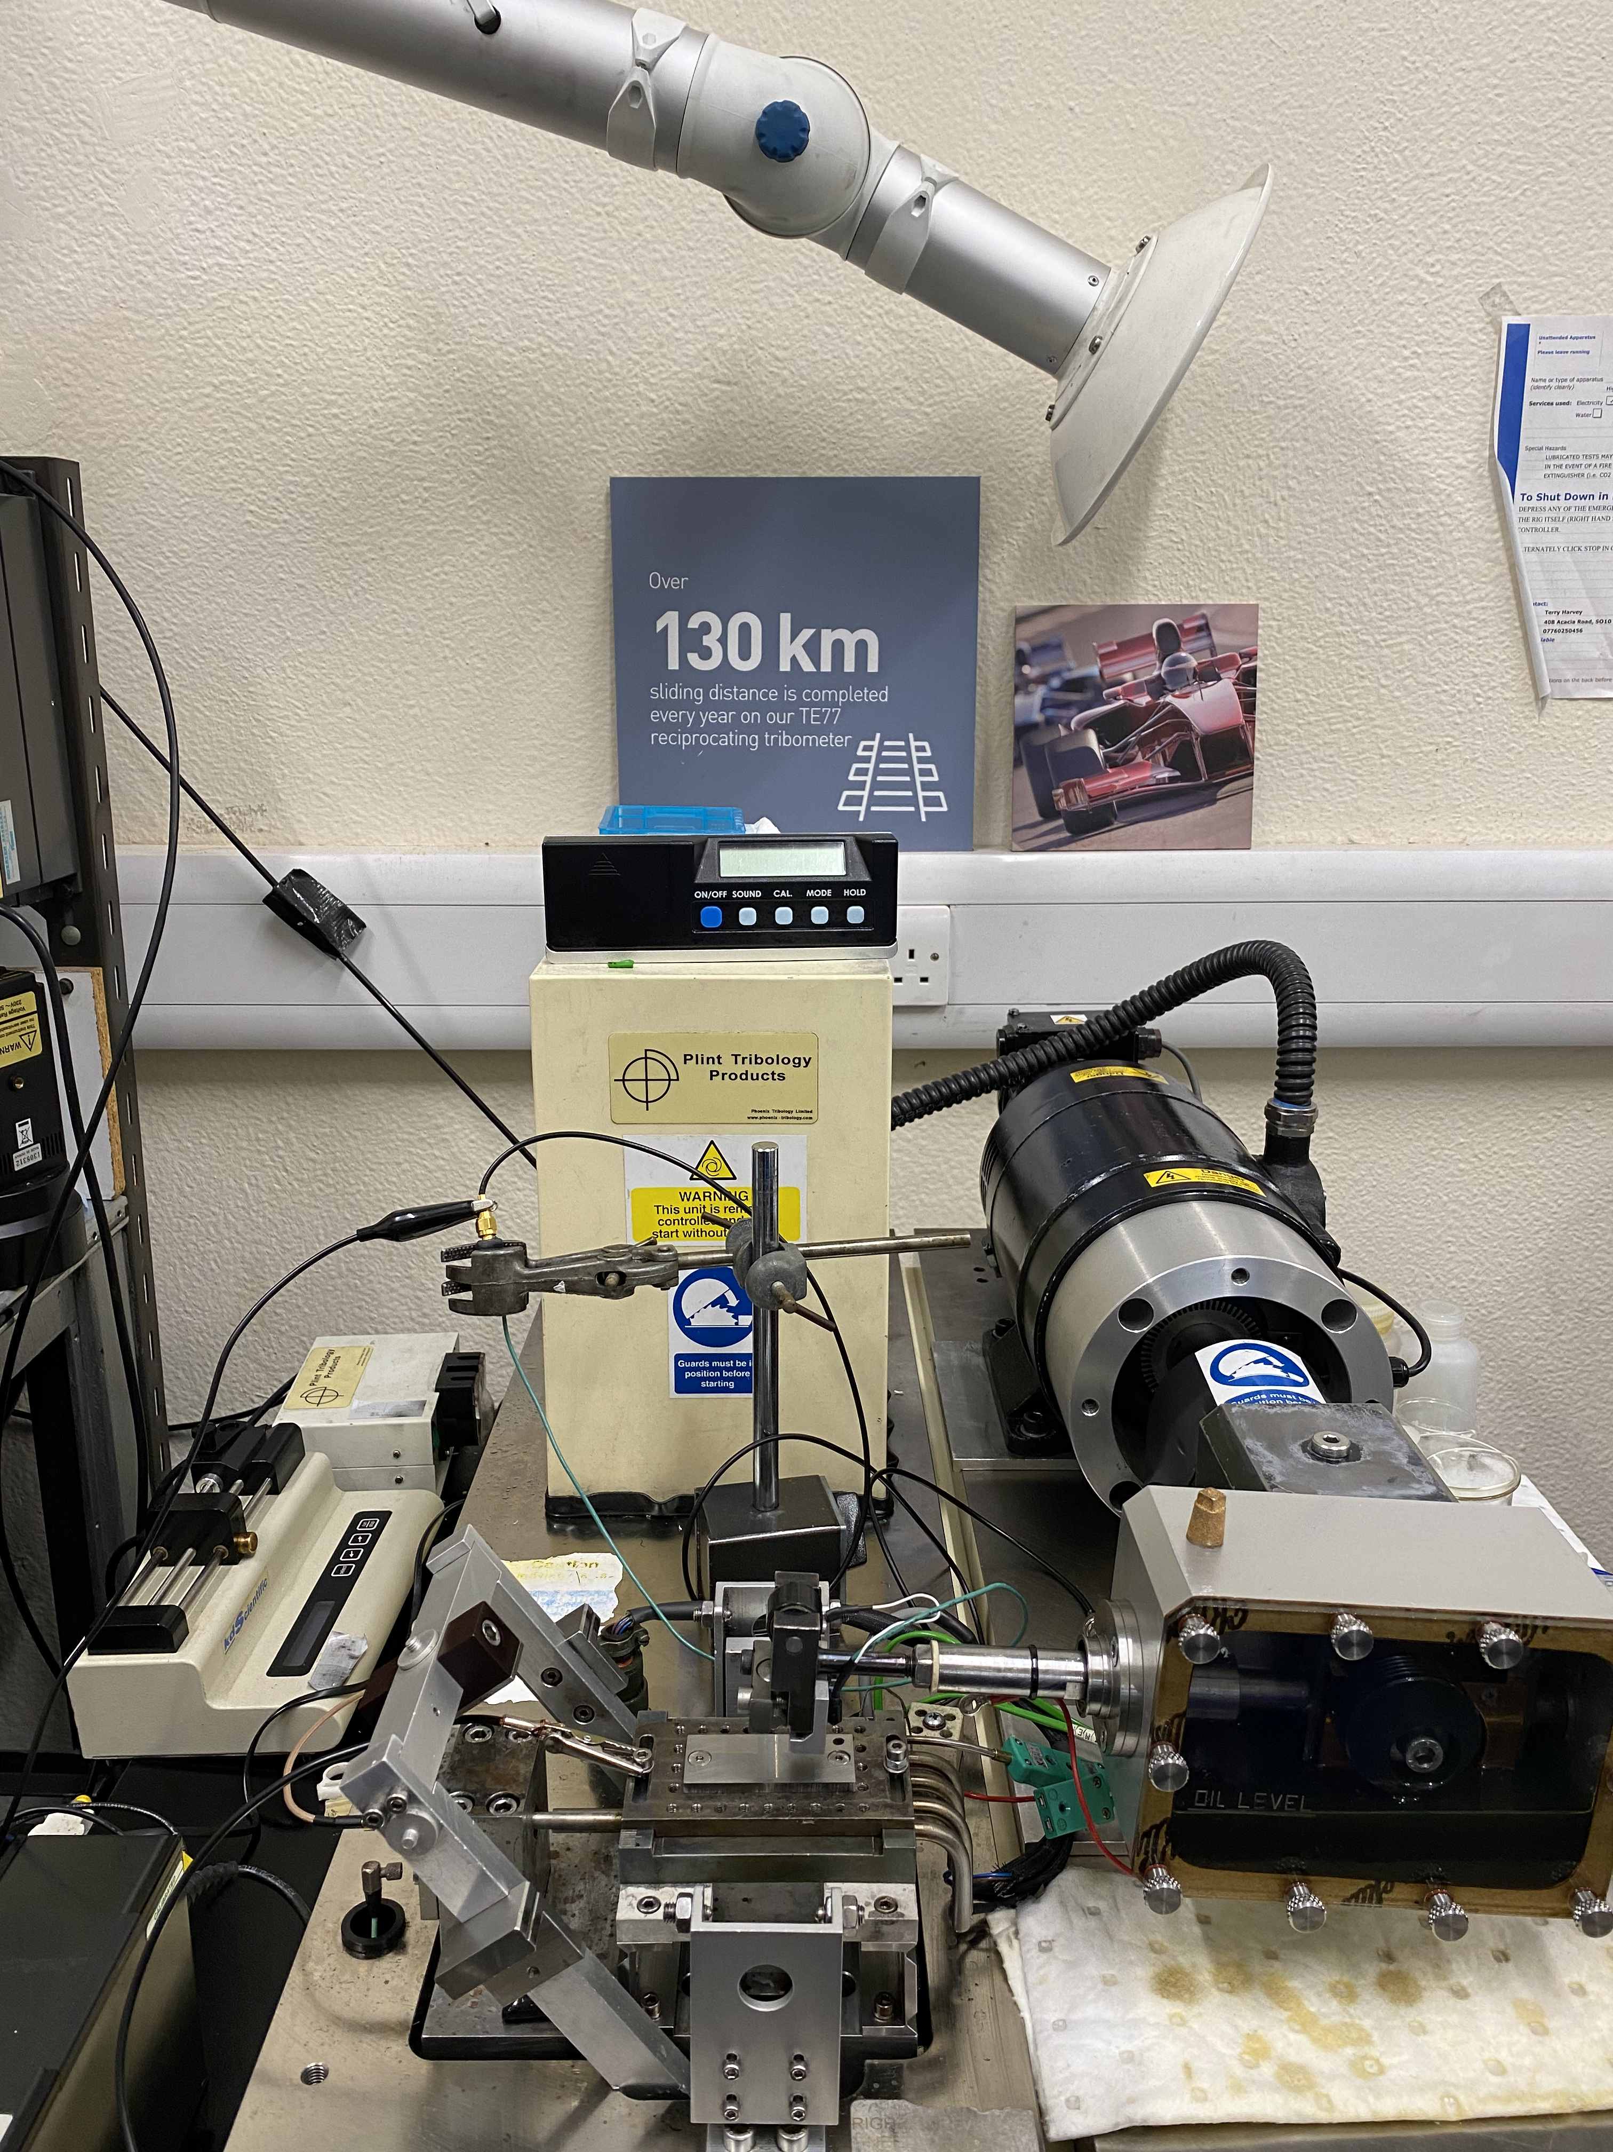
8. Statistical tests and future work
Flat washer – ball testing (MTM machine)
Three ball on rod
Friction measurements (TE77)
Notes:
Enter speaker notes here.

Slide 33
8. Statistical tests and future work
Focused ion beam and production of lamellae
TEM observation of tribofilm
Characterisation of friction compounds
Comparison with Pourbaix diagrams (Thermocalc)
Comparison with literature reports
Notes:
Enter speaker notes here.

Slide 34
Contact
http://lofrix.com/products/lofrix-dry.html
p.rivera1@Lancaster.ac.uk
Notes:
Enter speaker notes here.

Slide 35
Thank you!
Notes:
Enter speaker notes here.

